Slide 1


Cyber Insurance
COMS6998 sec:12 Economics of Cybersecurity
5 March 2024
“An insurance salesman in an office, selling a cyber insurance policy to a concerned business executive”

Slide 2
Why are we talking about insurance in a computer science class?
Accounts for billions of dollars of security spending
Insurers see an aggregate picture of risk and are financially motivated to estimate it correctly (in theory)
Insurers are in a position to tell us which security investments are worth making (in theory)

Slide 3
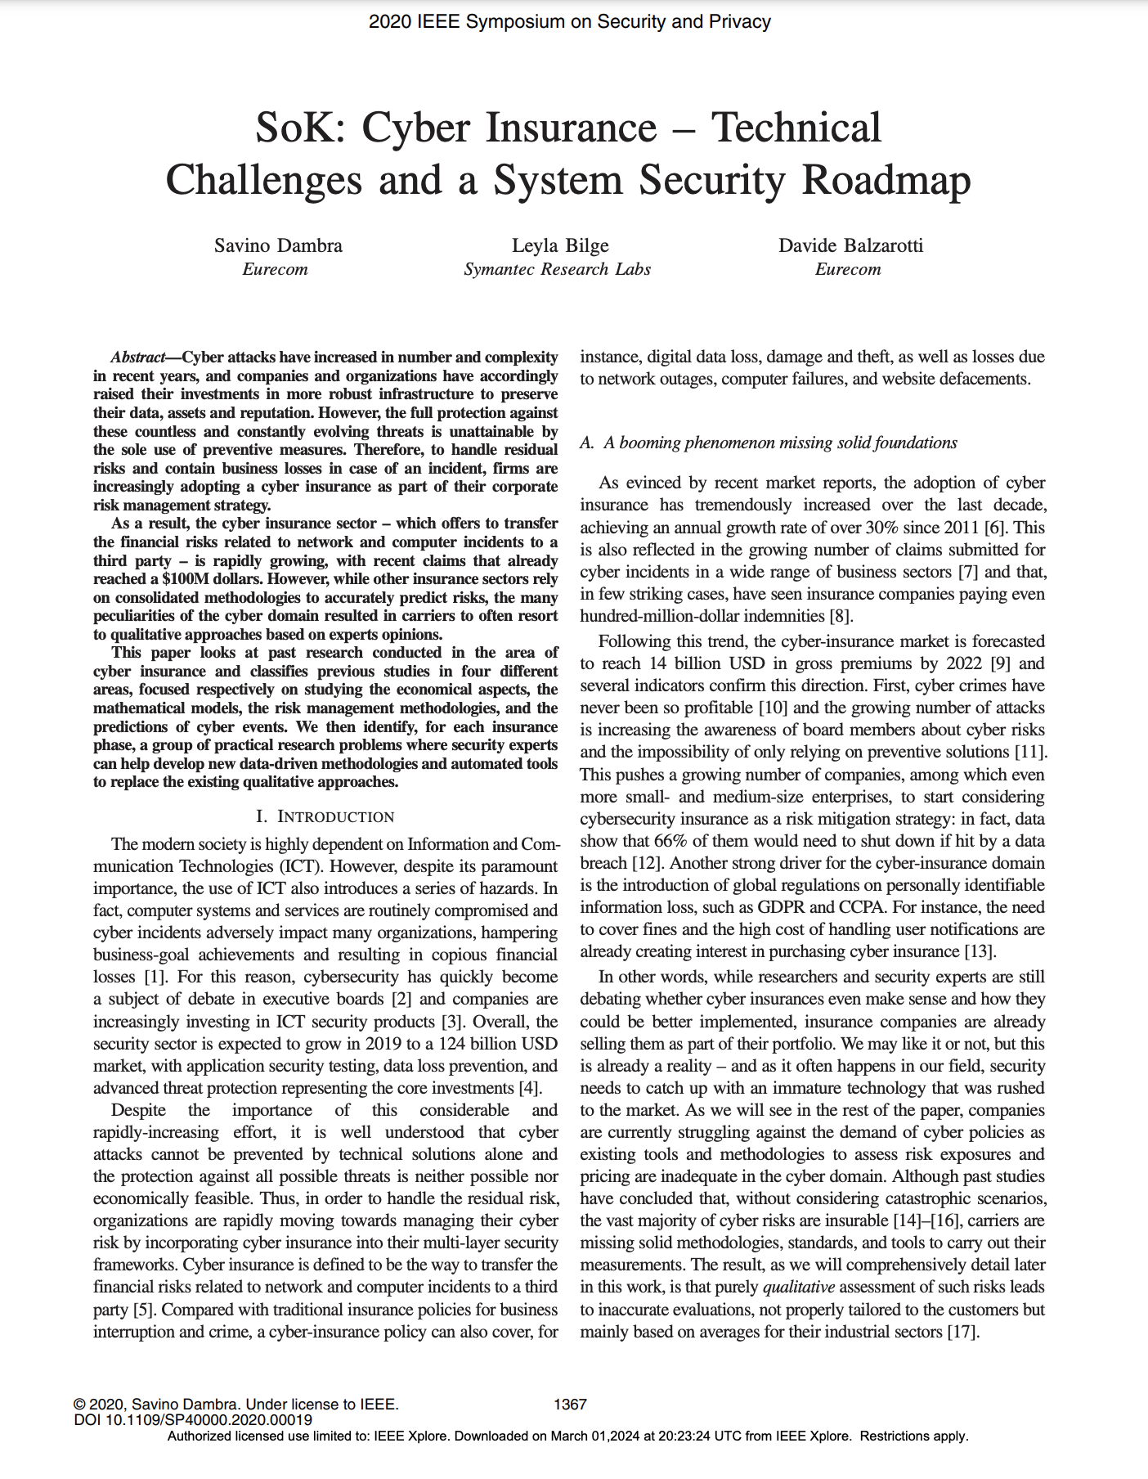
Notes:
Published in IEEE S&P — one of the premier venues for systems security work. A work about insurance! Shows it’s an important topic.
This is not just a topic for insurance people.
What is the purpose of this paper? What is an “SoK”? Initial thoughts? High-level questions?

Slide 4
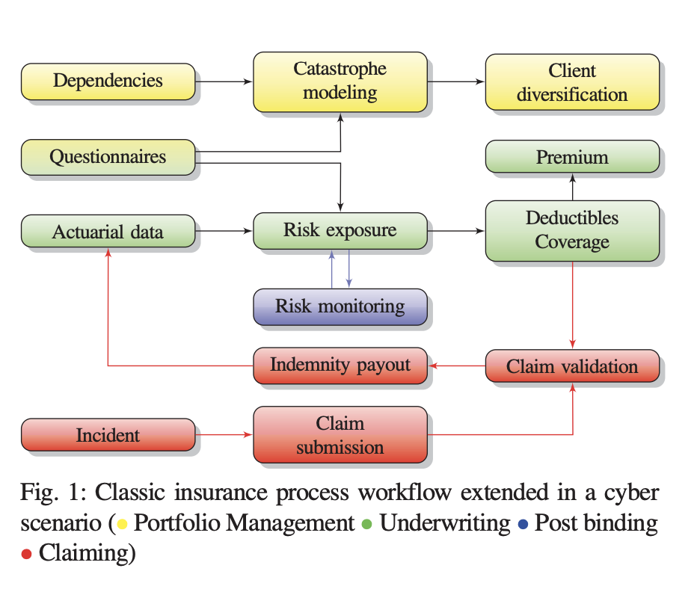
Notes:
What does this look like? (A systems diagram!)

Slide 5
Insurance basics + terminology
Insurer/Insurance company: The party who sells insurance
Insuree/insured/policyholder/claimant: The party who buys insurance
Policy: A contract between insurer and insuree specifying terms of insurance
Premium: The amount paid monthly/annually to keep the policy active
Retention/Deductible: Amount that policyholder is liable for (even with policy)
Limit: Maximum amount a policy will pay a policyholder
Exclusions: Clauses and conditions that are not covered by the policy
Underwriting: The process of creating a policy
https://www.insurance.ca.gov/01-consumers/105-type/95-guides/20-Glossary/
Notes:
This is basic material but there is a real chance you haven’t yet had to come across the world of insurance yet.
Many of you may still be on your parents health insurance!
Given that we’re in NYC, you probably don’t have a car and may not have ever had to deal with car insurance either.
Question: Many policies have a deductible. Why?
Answer: Because it reduces the problems of moral hazards
Underwriting: The process of creating a policy.
For many types of personal insurance that you or I may have experience with, there are readymade policies.
But when it comes to corporate insurance, policies are much more bespoke, meaning they are hand-tailored for each customer.

Slide 6
Insurance basics + terminology
Insurer/Insurance company: The party who sells insurance
Insuree/insured/policyholder/claimant: The party who buys insurance
Policy: A contract between insurer and insuree specifying terms of insurance
Premium: The amount paid monthly/annually to keep the policy active
Retention/Deductible: Amount that policyholder is liable for (even with policy)
Limit: Maximum amount a policy will pay a policyholder
Exclusions: Clauses and conditions that are not covered by the policy
Underwriting: The process of creating a policy
https://www.insurance.ca.gov/01-consumers/105-type/95-guides/20-Glossary/
Notes:
This is basic material but there is a real chance you haven’t yet had to come across the world of insurance yet.
Many of you may still be on your parents health insurance!
Given that we’re in NYC, you probably don’t have a car and may not have ever had to deal with car insurance either.
Question: Many policies have a deductible. Why?
Answer: Because it reduces the problems of moral hazards
Underwriting: The process of creating a policy.
For many types of personal insurance that you or I may have experience with, there are readymade policies.
But when it comes to corporate insurance, policies are much more bespoke, meaning they are hand-tailored for each customer.

Slide 7
Insurance basics + terminology
Insurer/Insurance company: The party who sells insurance
Insuree/insured/policyholder/claimant: The party who buys insurance
Policy: A contract between insurer and insuree specifying terms of insurance
Premium: The amount paid monthly/annually to keep the policy active
Retention/Deductible: Amount that policyholder is liable for (even with policy)
Limit: Maximum amount a policy will pay a policyholder
Exclusions: Clauses and conditions that are not covered by the policy
Underwriting: The process of creating a policy
https://www.insurance.ca.gov/01-consumers/105-type/95-guides/20-Glossary/
Notes:
This is basic material but there is a real chance you haven’t yet had to come across the world of insurance yet.
Many of you may still be on your parents health insurance!
Given that we’re in NYC, you probably don’t have a car and may not have ever had to deal with car insurance either.
Question: Many policies have a deductible. Why?
Answer: Because it reduces the problems of moral hazards
Underwriting: The process of creating a policy.
For many types of personal insurance that you or I may have experience with, there are readymade policies.
But when it comes to corporate insurance, policies are much more bespoke, meaning they are hand-tailored for each customer.

Slide 8
Insurance basics + terminology
Insurer/Insurance company: The party who sells insurance
Insuree/insured/policyholder/claimant: The party who buys insurance
Policy: A contract between insurer and insuree specifying terms of insurance
Premium: The amount paid monthly/annually to keep the policy active
Retention/Deductible: Amount that policyholder is liable for (even with policy)
Limit: Maximum amount a policy will pay a policyholder
Exclusions: Clauses and conditions that are not covered by the policy
Underwriting: The process of creating a policy
https://www.insurance.ca.gov/01-consumers/105-type/95-guides/20-Glossary/
Notes:
This is basic material but there is a real chance you haven’t yet had to come across the world of insurance yet.
Many of you may still be on your parents health insurance!
Given that we’re in NYC, you probably don’t have a car and may not have ever had to deal with car insurance either.
Question: Many policies have a deductible. Why?
Answer: Because it reduces the problems of moral hazards
Underwriting: The process of creating a policy.
For many types of personal insurance that you or I may have experience with, there are readymade policies.
But when it comes to corporate insurance, policies are much more bespoke, meaning they are hand-tailored for each customer.

Slide 9
Insurance basics + terminology
Insurer/Insurance company: The party who sells insurance
Insuree/insured/policyholder/claimant: The party who buys insurance
Policy: A contract between insurer and insuree specifying terms of insurance
Premium: The amount paid monthly/annually to keep the policy active
Retention/Deductible: Amount that policyholder is liable for (even with policy)
Limit: Maximum amount a policy will pay a policyholder
Exclusions: Clauses and conditions that are not covered by the policy
Underwriting: The process of creating a policy
https://www.insurance.ca.gov/01-consumers/105-type/95-guides/20-Glossary/
Notes:
This is basic material but there is a real chance you haven’t yet had to come across the world of insurance yet.
Many of you may still be on your parents health insurance!
Given that we’re in NYC, you probably don’t have a car and may not have ever had to deal with car insurance either.
Question: Many policies have a deductible. Why?
Answer: Because it reduces the problems of moral hazards
Underwriting: The process of creating a policy.
For many types of personal insurance that you or I may have experience with, there are readymade policies.
But when it comes to corporate insurance, policies are much more bespoke, meaning they are hand-tailored for each customer.

Slide 10
Insurance basics + terminology
Insurer/Insurance company: The party who sells insurance
Insuree/insured/policyholder/claimant: The party who buys insurance
Policy: A contract between insurer and insuree specifying terms of insurance
Premium: The amount paid monthly/annually to keep the policy active
Retention/Deductible: Amount that policyholder is liable for (even with policy)
Limit: Maximum amount a policy will pay a policyholder
Exclusions: Clauses and conditions that are not covered by the policy
Underwriting: The process of creating a policy
https://www.insurance.ca.gov/01-consumers/105-type/95-guides/20-Glossary/
Notes:
This is basic material but there is a real chance you haven’t yet had to come across the world of insurance yet.
Many of you may still be on your parents health insurance!
Given that we’re in NYC, you probably don’t have a car and may not have ever had to deal with car insurance either.
Question: Many policies have a deductible. Why?
Answer: Because it reduces the problems of moral hazards
Underwriting: The process of creating a policy.
For many types of personal insurance that you or I may have experience with, there are readymade policies.
But when it comes to corporate insurance, policies are much more bespoke, meaning they are hand-tailored for each customer.

Slide 11
Insurance basics + terminology
Insurer/Insurance company: The party who sells insurance
Insuree/insured/policyholder/claimant: The party who buys insurance
Policy: A contract between insurer and insuree specifying terms of insurance
Premium: The amount paid monthly/annually to keep the policy active
Retention/Deductible: Amount that policyholder is liable for (even with policy)
Limit: Maximum amount a policy will pay a policyholder
Exclusions: Clauses and conditions that are not covered by the policy
Underwriting: The process of creating a policy
https://www.insurance.ca.gov/01-consumers/105-type/95-guides/20-Glossary/
Notes:
This is basic material but there is a real chance you haven’t yet had to come across the world of insurance yet.
Many of you may still be on your parents health insurance!
Given that we’re in NYC, you probably don’t have a car and may not have ever had to deal with car insurance either.
Question: Many policies have a deductible. Why?
Answer: Because it reduces the problems of moral hazards
Underwriting: The process of creating a policy.
For many types of personal insurance that you or I may have experience with, there are readymade policies.
But when it comes to corporate insurance, policies are much more bespoke, meaning they are hand-tailored for each customer.

Slide 12
Insurance basics + terminology
Insurer/Insurance company: The party who sells insurance
Insuree/insured/policyholder/claimant: The party who buys insurance
Policy: A contract between insurer and insuree specifying terms of insurance
Premium: The amount paid monthly/annually to keep the policy active
Retention/Deductible: Amount that policyholder is liable for (even with policy)
Limit: Maximum amount a policy will pay a policyholder
Exclusions: Clauses and conditions that are not covered by the policy
Underwriting: The process of creating a policy
https://www.insurance.ca.gov/01-consumers/105-type/95-guides/20-Glossary/
Notes:
This is basic material but there is a real chance you haven’t yet had to come across the world of insurance yet.
Many of you may still be on your parents health insurance!
Given that we’re in NYC, you probably don’t have a car and may not have ever had to deal with car insurance either.
Question: Many policies have a deductible. Why?
Answer: Because it reduces the problems of moral hazards
Underwriting: The process of creating a policy.
For many types of personal insurance that you or I may have experience with, there are readymade policies.
But when it comes to corporate insurance, policies are much more bespoke, meaning they are hand-tailored for each customer.

Slide 13
Insurance basics + terminology
Claim: A request by an policyholder to receive compensation for a covered loss
First-Party Losses: Financial harms incurred by the policyholder
Third-Party Losses: Financial harms incurred parties other than policyholder
Diversification: A strategy for avoiding catastrophic losses by covering many different types of policyholders with independent probabilities of losses
https://www.insurance.ca.gov/01-consumers/105-type/95-guides/20-Glossary/
Notes:
First party losses are what come to mind when you think of insurance.
In cyber insurance, most of the claim money is actually spent on covering third party losses!
Many people depend on companies for services
Diversification:
A strategy for avoiding catastrophic losses by covering many different types of policyholders with independent probabilities of losses
If you sell flood insurance, and all of your customers live in houses in the same flood zone, and there’s a big flood, you’re going to have to pay out to all of your customers at the same time.
You probably aren’t going to have the money on hand to do this! So you might collapse, and nobody gets any claims back
A better strategy would be to insure people spread out across the country, where a flood in one area doesn’t mean you have to pay all your customers at once
This is diversification.

Slide 14
Insurance basics + terminology
Claim: A request by an policyholder to receive compensation for a covered loss
First-Party Losses: Financial harms incurred by the policyholder
Third-Party Losses: Financial harms incurred parties other than policyholder
Diversification: A strategy for avoiding catastrophic losses by covering many different types of policyholders with independent probabilities of losses
https://www.insurance.ca.gov/01-consumers/105-type/95-guides/20-Glossary/
Notes:
First party losses are what come to mind when you think of insurance.
In cyber insurance, most of the claim money is actually spent on covering third party losses!
Many people depend on companies for services
Diversification:
A strategy for avoiding catastrophic losses by covering many different types of policyholders with independent probabilities of losses
If you sell flood insurance, and all of your customers live in houses in the same flood zone, and there’s a big flood, you’re going to have to pay out to all of your customers at the same time.
You probably aren’t going to have the money on hand to do this! So you might collapse, and nobody gets any claims back
A better strategy would be to insure people spread out across the country, where a flood in one area doesn’t mean you have to pay all your customers at once
This is diversification.

Slide 15
Insurance basics + terminology
Claim: A request by an policyholder to receive compensation for a covered loss
First-Party Losses: Financial harms incurred by the policyholder
Third-Party Losses: Financial harms incurred parties other than policyholder
Diversification: A strategy for avoiding catastrophic losses by covering many different types of policyholders with independent probabilities of losses
https://www.insurance.ca.gov/01-consumers/105-type/95-guides/20-Glossary/
Notes:
First party losses are what come to mind when you think of insurance.
In cyber insurance, most of the claim money is actually spent on covering third party losses!
Many people depend on companies for services
Diversification:
A strategy for avoiding catastrophic losses by covering many different types of policyholders with independent probabilities of losses
If you sell flood insurance, and all of your customers live in houses in the same flood zone, and there’s a big flood, you’re going to have to pay out to all of your customers at the same time.
You probably aren’t going to have the money on hand to do this! So you might collapse, and nobody gets any claims back
A better strategy would be to insure people spread out across the country, where a flood in one area doesn’t mean you have to pay all your customers at once
This is diversification.

Slide 16
Insurance basics + terminology
Claim: A request by an policyholder to receive compensation for a covered loss
First-Party Losses: Financial harms incurred by the policyholder
Third-Party Losses: Financial harms incurred parties other than policyholder
Diversification: A strategy for avoiding catastrophic losses by covering many different types of policyholders with independent probabilities of losses
https://www.insurance.ca.gov/01-consumers/105-type/95-guides/20-Glossary/
Notes:
First party losses are what come to mind when you think of insurance.
In cyber insurance, most of the claim money is actually spent on covering third party losses!
Many people depend on companies for services
Diversification:
A strategy for avoiding catastrophic losses by covering many different types of policyholders with independent probabilities of losses
If you sell flood insurance, and all of your customers live in houses in the same flood zone, and there’s a big flood, you’re going to have to pay out to all of your customers at the same time.
You probably aren’t going to have the money on hand to do this! So you might collapse, and nobody gets any claims back
A better strategy would be to insure people spread out across the country, where a flood in one area doesn’t mean you have to pay all your customers at once
This is diversification.
Are there any other terms from any of the readings that I can help clarify at this time?

Slide 17
What are some of the challenges facing cyber insurance?
Notes:
Asymmetric information leads to adverse selection
Someone remind me — what does this mean?
Risk estimation is difficult due to interdependent nature of tech
E.g. your software depends on an open source
Not enough actuarial information to accurately price risk
Many incidents go unreported to save reputation
What is the consequence? Not enough data to build actuarial models
Threats are constantly adapting and evolving
Why does this make it difficult to estimate risk?
Tech monocultures prevent diversification
What’s a monoculture? E.g. most enterprises use Microsoft Windows. If a 0-day vulnerability is found in Windows operating systems, everyone can be vulnerable at once. Can lead to catastrophic losses for insurers
Market lacks reinsurers
What are reinsurers? Insurance for insurance companies
Post-binding phase drives up costs
Post binding is to help avoid what problem? (moral hazard)
Paper says that this is unique to cyber insurance, which I found interesting. Why do we think this is?
Harms can be intangible and hard to precisely quantify
How do you measure “loss of reputation”? Or the business impact of this?

Slide 18
What are some of the challenges facing cyber insurance?
Asymmetric information leads to adverse selection
Risk estimation is difficult due to interdependent nature of tech
Not enough actuarial information to accurately price risk
Many incidents go unreported to save reputation
Threats are constantly adapting and evolving
Tech monocultures prevent diversification
Market lacks reinsurers
Post-binding phase drives up costs
Harms can be intangible and hard to precisely quantify
Notes:
Asymmetric information leads to adverse selection
Someone remind me — what does this mean?
Risk estimation is difficult due to interdependent nature of tech
E.g. your software depends on an open source
Not enough actuarial information to accurately price risk
Many incidents go unreported to save reputation
What is the consequence? Not enough data to build actuarial models
Threats are constantly adapting and evolving
Why does this make it difficult to estimate risk?
Tech monocultures prevent diversification
What’s a monoculture? E.g. most enterprises use Microsoft Windows. If a 0-day vulnerability is found in Windows operating systems, everyone can be vulnerable at once. Can lead to catastrophic losses for insurers
Market lacks reinsurers
What are reinsurers? Insurance for insurance companies
Post-binding phase drives up costs
Post binding is to help avoid what problem? (moral hazard)
Paper says that this is unique to cyber insurance, which I found interesting. Why do we think this is?
Harms can be intangible and hard to precisely quantify
How do you measure “loss of reputation”? Or the business impact of this?

Slide 19
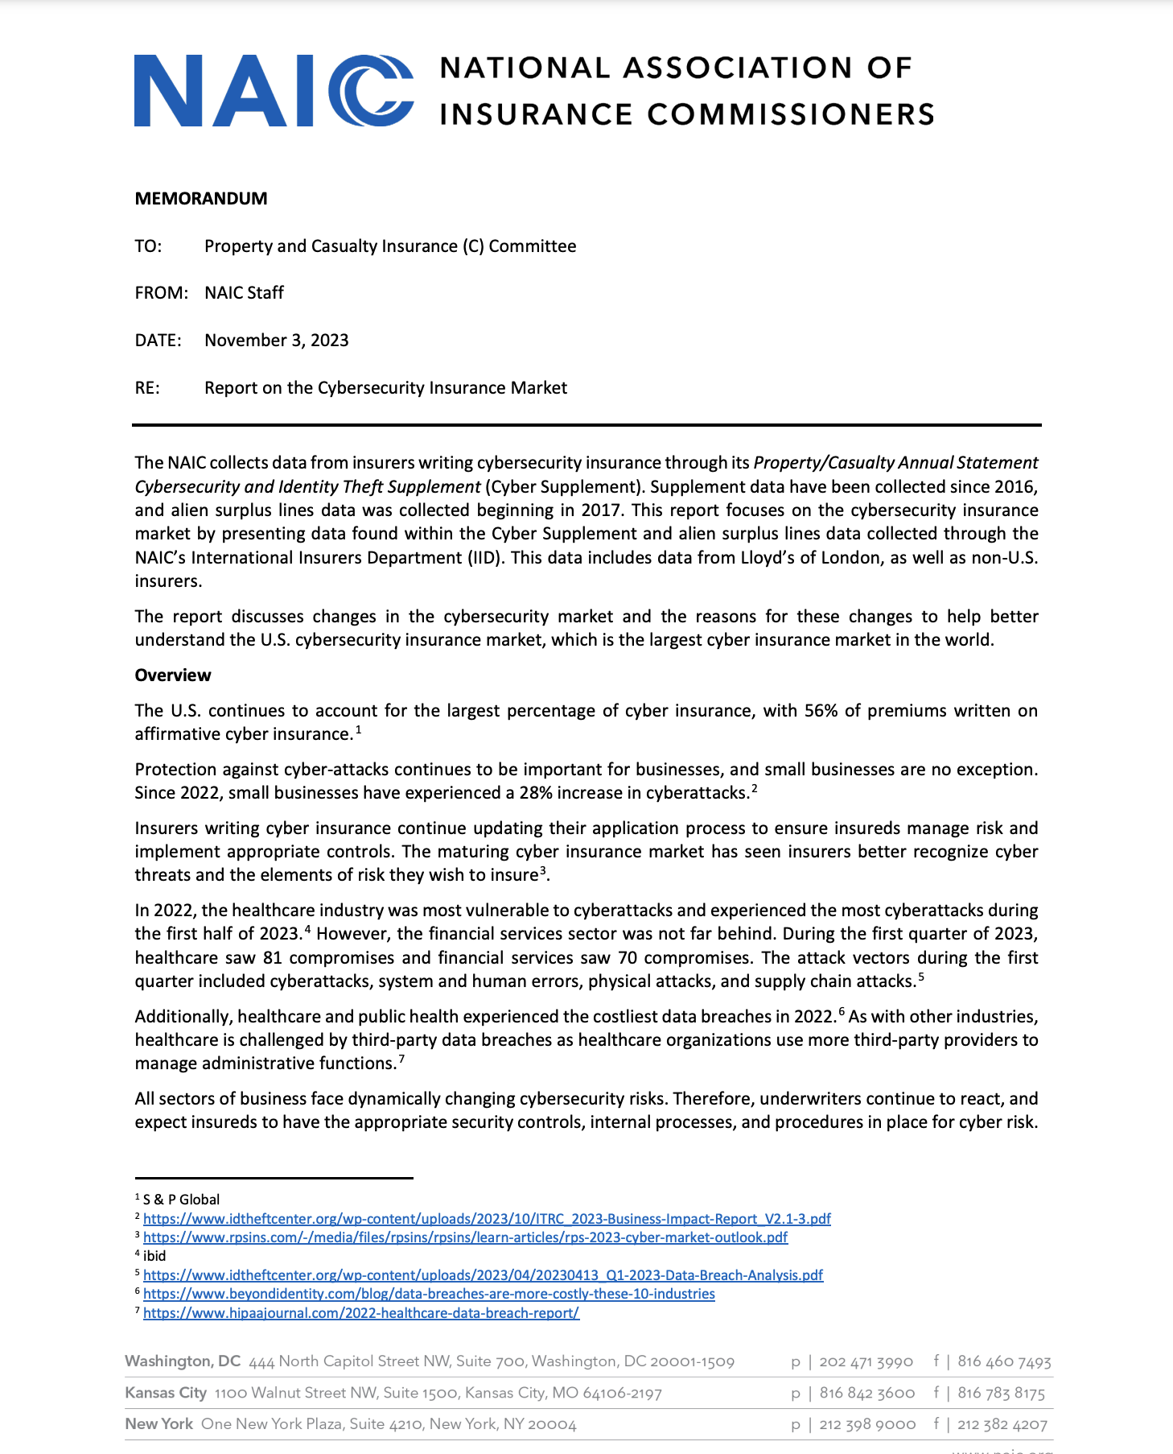
Notes:
Who is the NAIC and why do they have all this data?
A bit of jargon that you of course looked up :)
But we’re going to go through this report at a fine-grained level anyway
Can someone summarize what this report is?

Slide 20
How much is spent on cyber insurance each year?
$1M
$10M
$100M
$1B
$10B

Slide 21
How much is spent on cyber insurance each year?
$1M
$10M
$100M
$1B
$10B
Notes:
Framing effect?

Slide 22
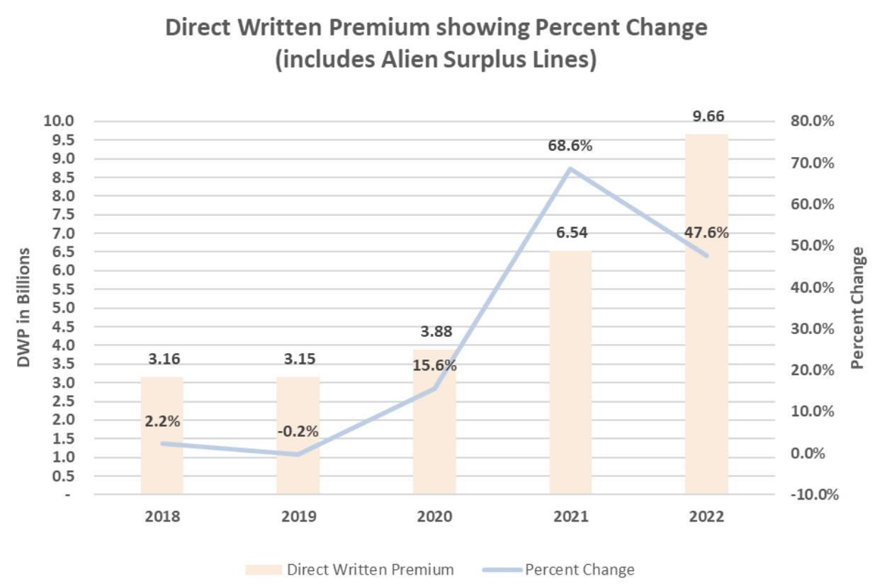
Notes:
Direct written premiums is almost $10B here in 2022. Let’s make sure we understand all the terminology being used here

Slide 23
?
Notes:
Direct Written Premiums, or DWP: The amount of money that insurance companies collected as premiums before they themselves buy reinsurance.
Interchangeable with “revenue”, I think

Slide 24
?
Notes:
What are “Alien Surplus Lines”?
“Alien” just means the insurance company is located outside of the United States
“Surplus Lines” = niche, uncommon insurance that regular insurance providers do not offer
For whatever reason they often go hand in hand.
Hence this chart shows all forms of cyber insurance spending in the country

Slide 25
Notes:
This shows the cyber insurance market as a whole.
In 2022, how much was spent on premiums? 9.7B
How does that compare to the amount spent on e.g. Ransomware? Harms were estimated to be also in the billions. Which one is hurting companies more?
Costs of insurance are easy to measure
Costs of ransomware can be harder to measure (ransom payment is easy; what about loss of reputation?)
A couple of things to point out:
This hasn’t been steady growth though. Before 2020 the market was shrinking, and there was concerns over the viability of the market.
Huge growth in recent years! The market has tripled since 2019
Does this mean that the insurers are selling a great product which is causing more and more people to buy cyber insurance?
Yes?
No?

Slide 26
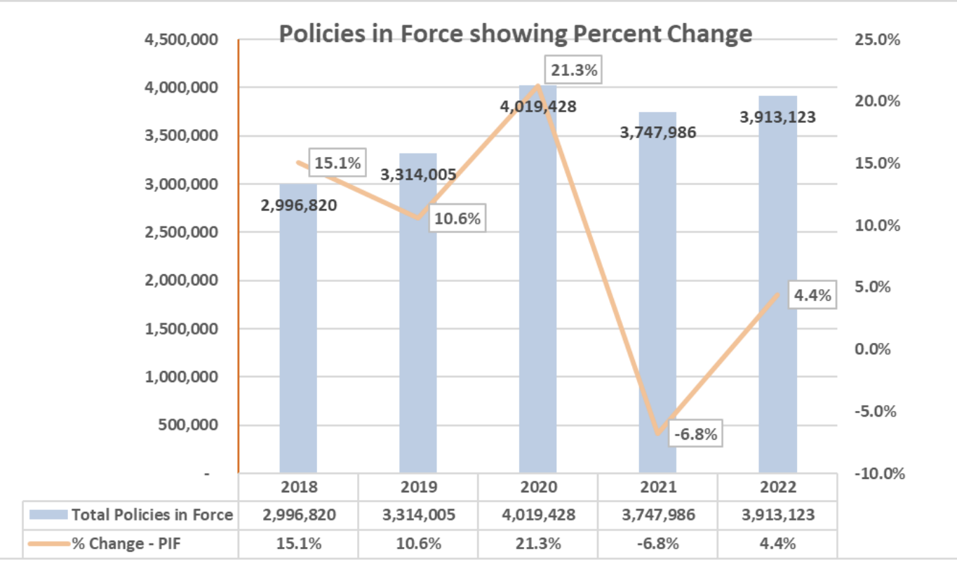
Notes:
No. Number of policies peaked in 2020!
What does this mean? (Almost the same number of policies in 2019 and 2022, but DWP is three times higher! Same customers are paying much more for insurance!)

Slide 27
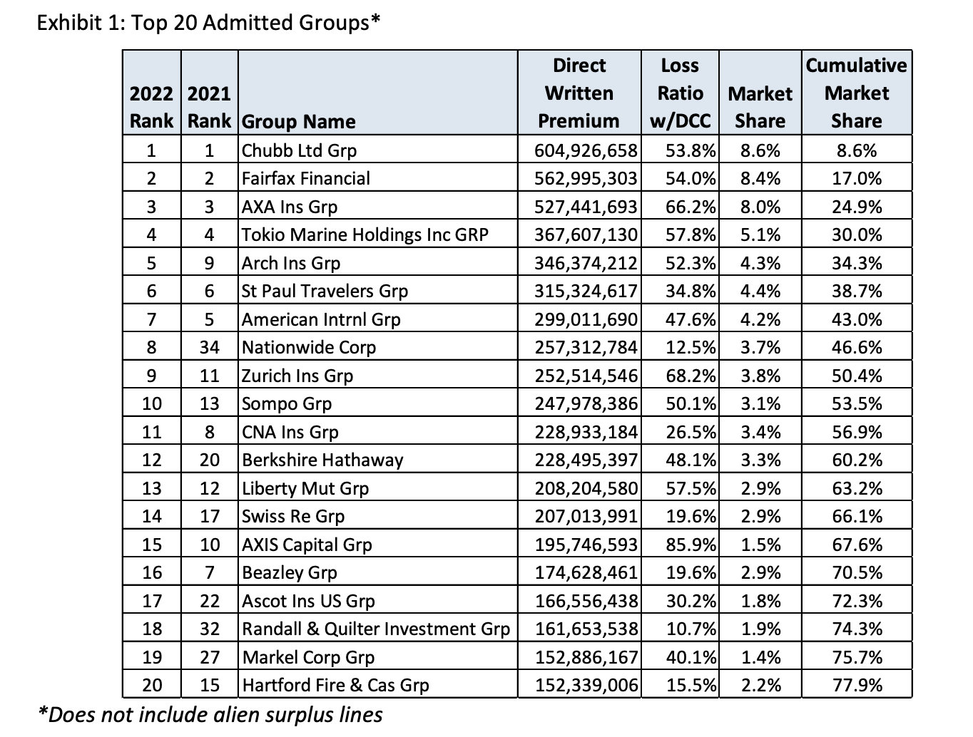
Notes:
(77.9% of the market)
Has anyone ever heard of any of these companies before? (Maybe Berkshire Hathaway? Nationwide, Liberty Mutual, only because they also sell personal insurance policies like home and auto)
This represents several billions of dollars worth of cybersecurity spending
The most interesting column here is “Loss Ratio w/ DCC”
What is “DCC”?
“defense and cost containment”, i.e. “Defense and Cost Containment Expenses means expenses paid or incurred for defense, litigation and cost containment services. The amounts reported for an insuring entity’s or self-insurer’s employees should include overhead, just as an outside firm’s charges would include.”
Source: https://www.lawinsider.com/dictionary/defense-and-cost-containment-expenses
Anyone remember the average loss ratio? 44.6%
What else stands out? (Big range—10.7% to 85.9%!)
What is a typical loss ratio?
In healthcare, after the affordable care act, it was mandated that the loss ratio had to be a minimum of 80%, and if the loss ratio was below 80%, the difference had to be paid out to policyholders in the form of rebates.
Auto insurance has had a loss ratio of over 100% in 11 out of the last 12 years. Meaning it has been unprofitable
House insurance loss ratios have also been above 100% in the last few years
Meanwhile, cyber insurance peaked at around 70% a few years ago, and is now down to 44.6%.
Why??
Cyber is new, insurers don’t know how to price it properly, potential for huge losses (lack of diversification in security)
Quote from the report: “It is important to note that the cybersecurity insurance market is still developing and growing” — trying to justify the enormous profits?

Slide 28
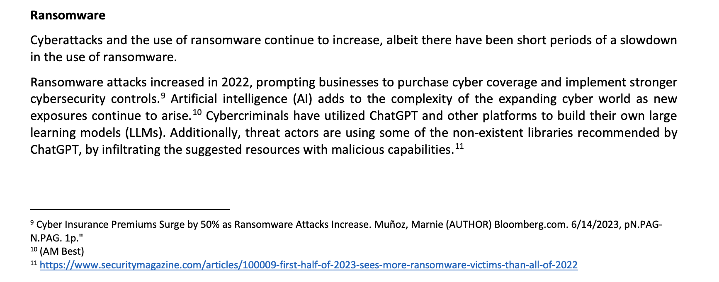
Notes:
The rest of the report is analysis.
Includes this hilarious mistake: “Cybercriminals have utilized ChatGPT and other platforms to build their own large learning models (LLMs)”
These people are not technologists
And yet they represent and industry that collects literal billions of dollars in cybersecurity spending.
Something to think about…
Any other thoughts or comments or questions before we move on?

Slide 29

Notes:
“the goal of this research is to provide transparency around the three main components of cyber insurance policies: coverage and exclusions, security questionnaires, and rate schedules“

Slide 30
How was the data acquired?
Publicly available records
Interviewing insurance companies
Interviewing insurance policyholders
Posing as a company and submitting fake requests to insurance companies for insurance policies

Slide 31
How was the data acquired?
Publicly available records
Interviewing insurance companies
Interviewing insurance policyholders
Posing as a company and submitting fake requests to insurance companies for insurance policies

Slide 32
How did the authors determine the number of policies to analyze?
Thematic analysis
Semi-random election
Inductive exhaustion
Ranked sampling

Slide 33
How did the authors determine the number of policies to analyze?
Thematic analysis
Semi-random election
Inductive exhaustion
Ranked sampling

Slide 34
Aside on qualitative research
Imagine you have a large amount of unstructured text (via documents/interviews/etc.)
There are themes and patterns in the text but you don’t know what they are
How can you rigorously find important takeaways in the data?
How can you quantify trends in qualitative data?
Notes:
I think some computer scientists and other mathematical/quantitative types are put off by qualitative research
“It’s so subjective!”
Well, maybe, but oftentimes (especially in security!) we don’t have quantitative data to work with and are forced to rely on qualitative methods.

Slide 35
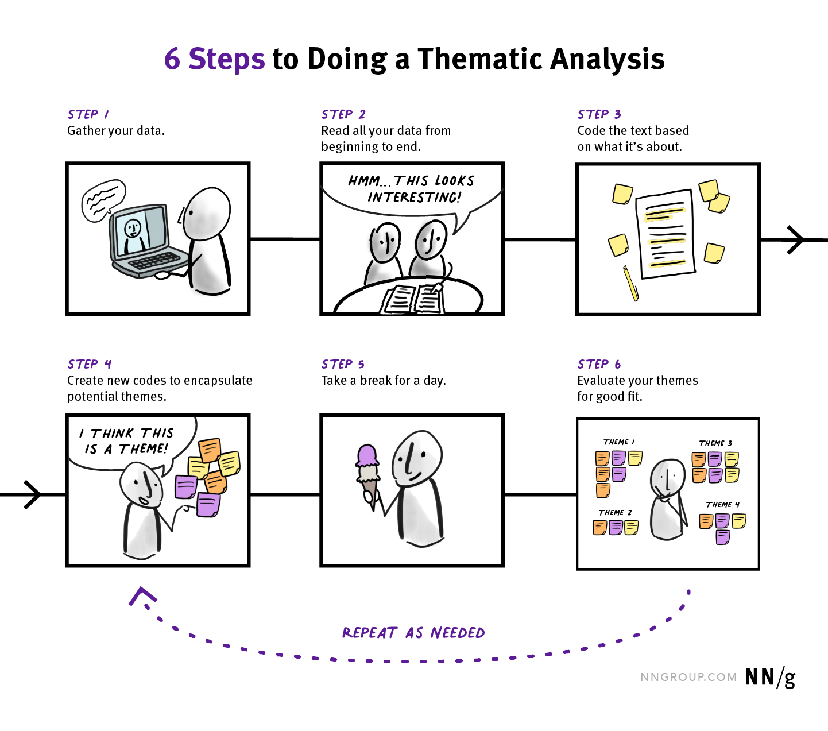
Aside on qualitative research
https://www.nngroup.com/articles/thematic-analysis/
Notes:
“Thematic saturation” is when you’ve done steps 1--6 for a number of source a number of times and you’ve developed a big enough and refined enough codebook so that when you pick up a new source document, you find that it neatly can be parsed using the codebook you’ve developed. It’s a probabilistic proof that your codebook is big enough and refined enough
It’s a best effort approach to make sense of qualitative data.
Any questions on that?
I’ve never personally done it but some of you may need to do some element of this for your projects.
How do you avoid inserting personal bias in this process? I don’t know. Try your best I guess. In this paper, they said that their coding was a fairly objective process, facilitated by the fact that the policies are somewhat standardized. So not entirely subjective.

Slide 36
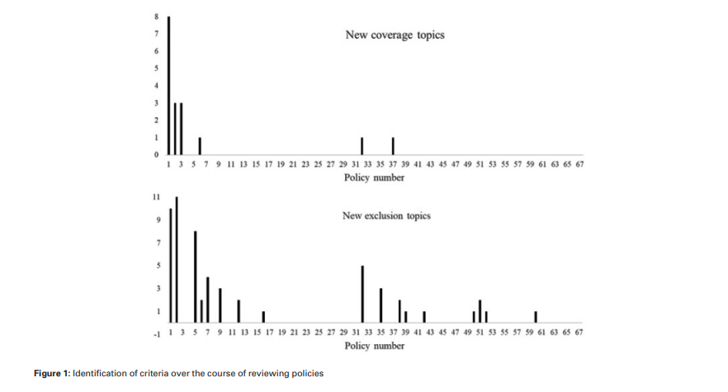
Notes:
Not too surprising — most coverage and exclusion topics came up in the first few rounds of analysis

Slide 37
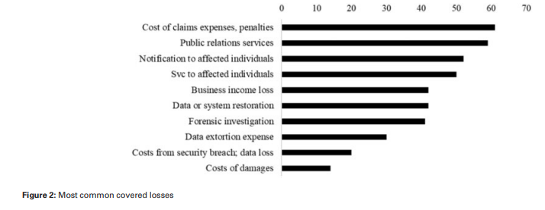
Notes:
Most common covered losses
What stands out? The most common covered losses are third party losses!
Essentially “cleanup costs”
Note—when writing papers, vectorize your images!!! Don’t rasterize. Not my fault it’s blurry.

Slide 38
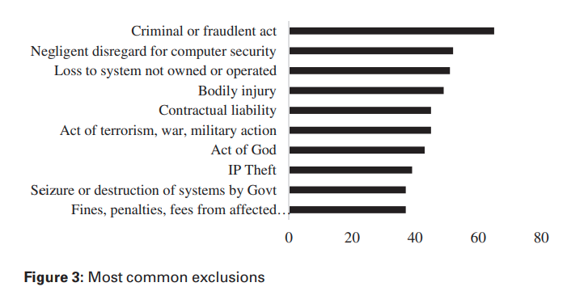
Notes:
(Vectorized in this image!)
Remind me--what are exclusions? Is this saying you can’t receive a claim if you are the victim of a criminal or fraudulent act?
No — it’s saying you can’t receive a claim if you the policyholder were engaging in criminal or fraudulent acts
How do you define “negligent disregard for computer security”...?
What is an “Act of God”? In most insurance, things like natural disasters. May or may not be excluded. Not sure what exactly it means in this case, but it’s not referring to any religious deity.

Slide 39
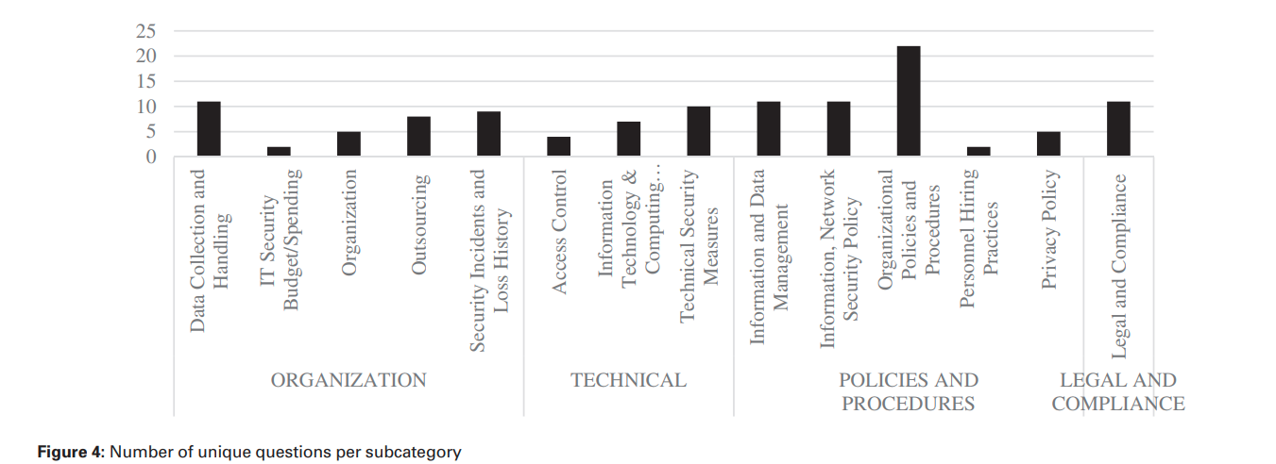
Notes:
The authors also coded the documents for security questionnaires, ostensibly designed to elicit security posture.
Only 31 out of 235 used questionnaires. Is this surprising?
This is what the authors came up with: four categories, fourteen subcategories.
What is surprising about this figure?
Technical measures are only a small portion of security questionnaires
This is a point that the next paper makes —- there’s a lot of room for technical people (like ourselves) to apply what we know about systems and security to provide better ways of estimating risk
Why do we think this is?
Are insurers bad at understanding the technical elements of security?
If so, it’s a bad sign for the effectiveness of using insurance to provide security?
Recall “Large Learning Models”...
From the paper:
“It is noteworthy, however, that standards and frameworks for
information technology management, such as the ITIL and
COBIT are not mentioned, and in only one instance was an
ISO standard mentioned. Also, the recently developed NIST
Cybersecurity framework is not mentioned, though from
conversations with carriers, they are beginning to integrate
it into these questionnaires.”
“Only in one instance, did a questionnaire asked about the size of
the IT/information security budget and how it is spent with regard
to prevention, detection, and response to security incidents. This
finding was surprising given the amount of money spent on IT and
information security could serve as a useful indicator for security
maturity.”

Slide 40
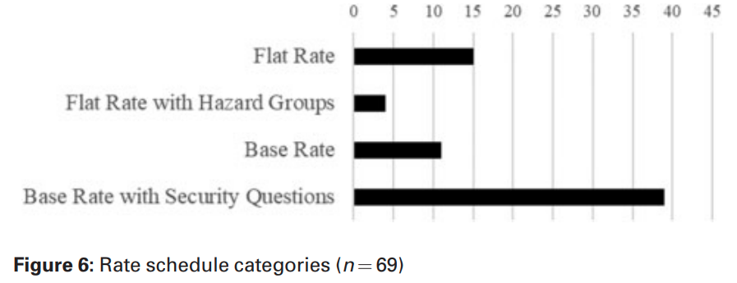
Notes:
Increase with sophistication the further down you go
Flat rate — regardless of size or security!
Seems to be offered to smaller companies. Maybe makes sense
Flat rate with Hazard Groups:
Examples of low hazard businesses, per this policy, were accounting offices, automobile shops and barber shops
Base rate: A series of lookup tables
Company size, industry, incident history, etc. each act as scaling factors

Slide 41
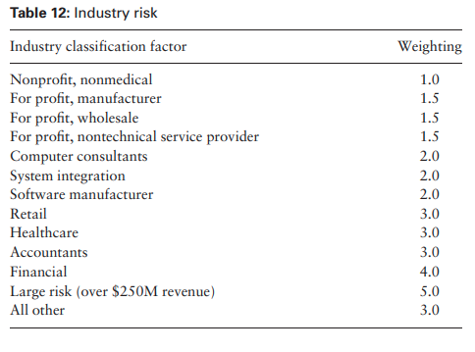
Notes:
E.g. insurance companies think that retail is 3x riskier than non-medical non-profits.

Slide 42
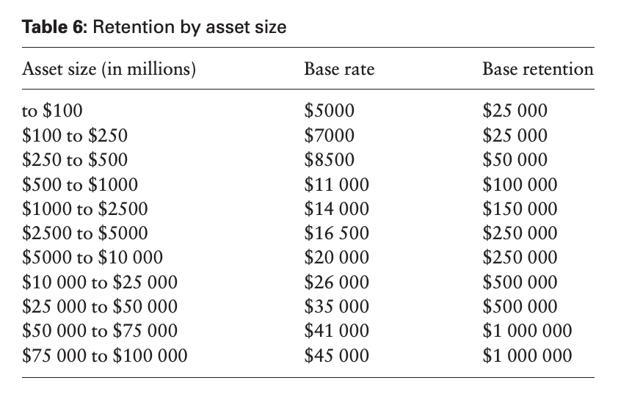
Notes:
What is “asset size”? The amount

Slide 43
Notes:
Last one was “Base Rate with Security Questions”

Slide 44
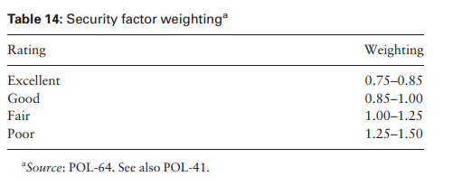
Notes:
Based on the questionnaires, but ultimately still a bit subjective here

Slide 45
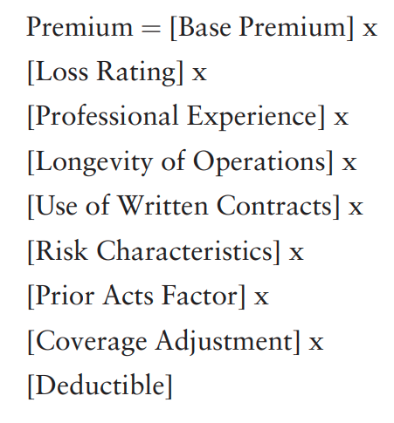
Notes:
Here’s one policy’s way of calculating premiums

Slide 46
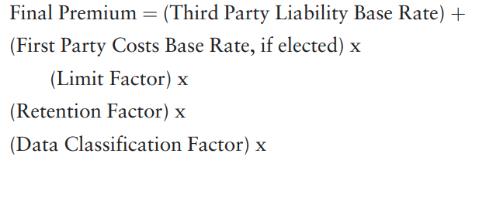
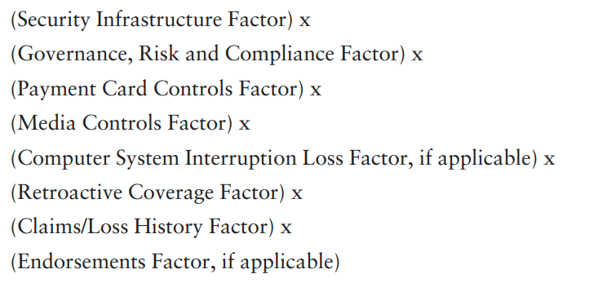
Notes:
Here’s another
What stands out? Does this feel sophisticated? Unsophisticated?
“From our analysis, the first and most important firm characteristic used
to compute insurance premiums was the firm’s asset value
(or revenue) base rate, rather than specific technology or governance
controls. This appears to be the single most common proxy for firm
size, and therefore risk.”
“Beyond the specific equations, however, it is unclear which level
of sophistication of premium calculation is optimal for the firm, and
is best able to assess an applicant’s risk. Indeed, this remains an outstanding issue among carriers.”

Slide 47
Napkin math
Likelihood of ransomware incident: 23%
Average cost of ransomware event: $2M
Expected loss : $460K
Average premium

Slide 48
Notes:
Published in IEEE S&P — one of the premier venues for systems security work. A work about insurance! Shows it’s an important topic.
This is not just a topic for insurance people.
What is the purpose of this paper? What is an “SoK”? Initial thoughts? High-level questions?

Slide 49
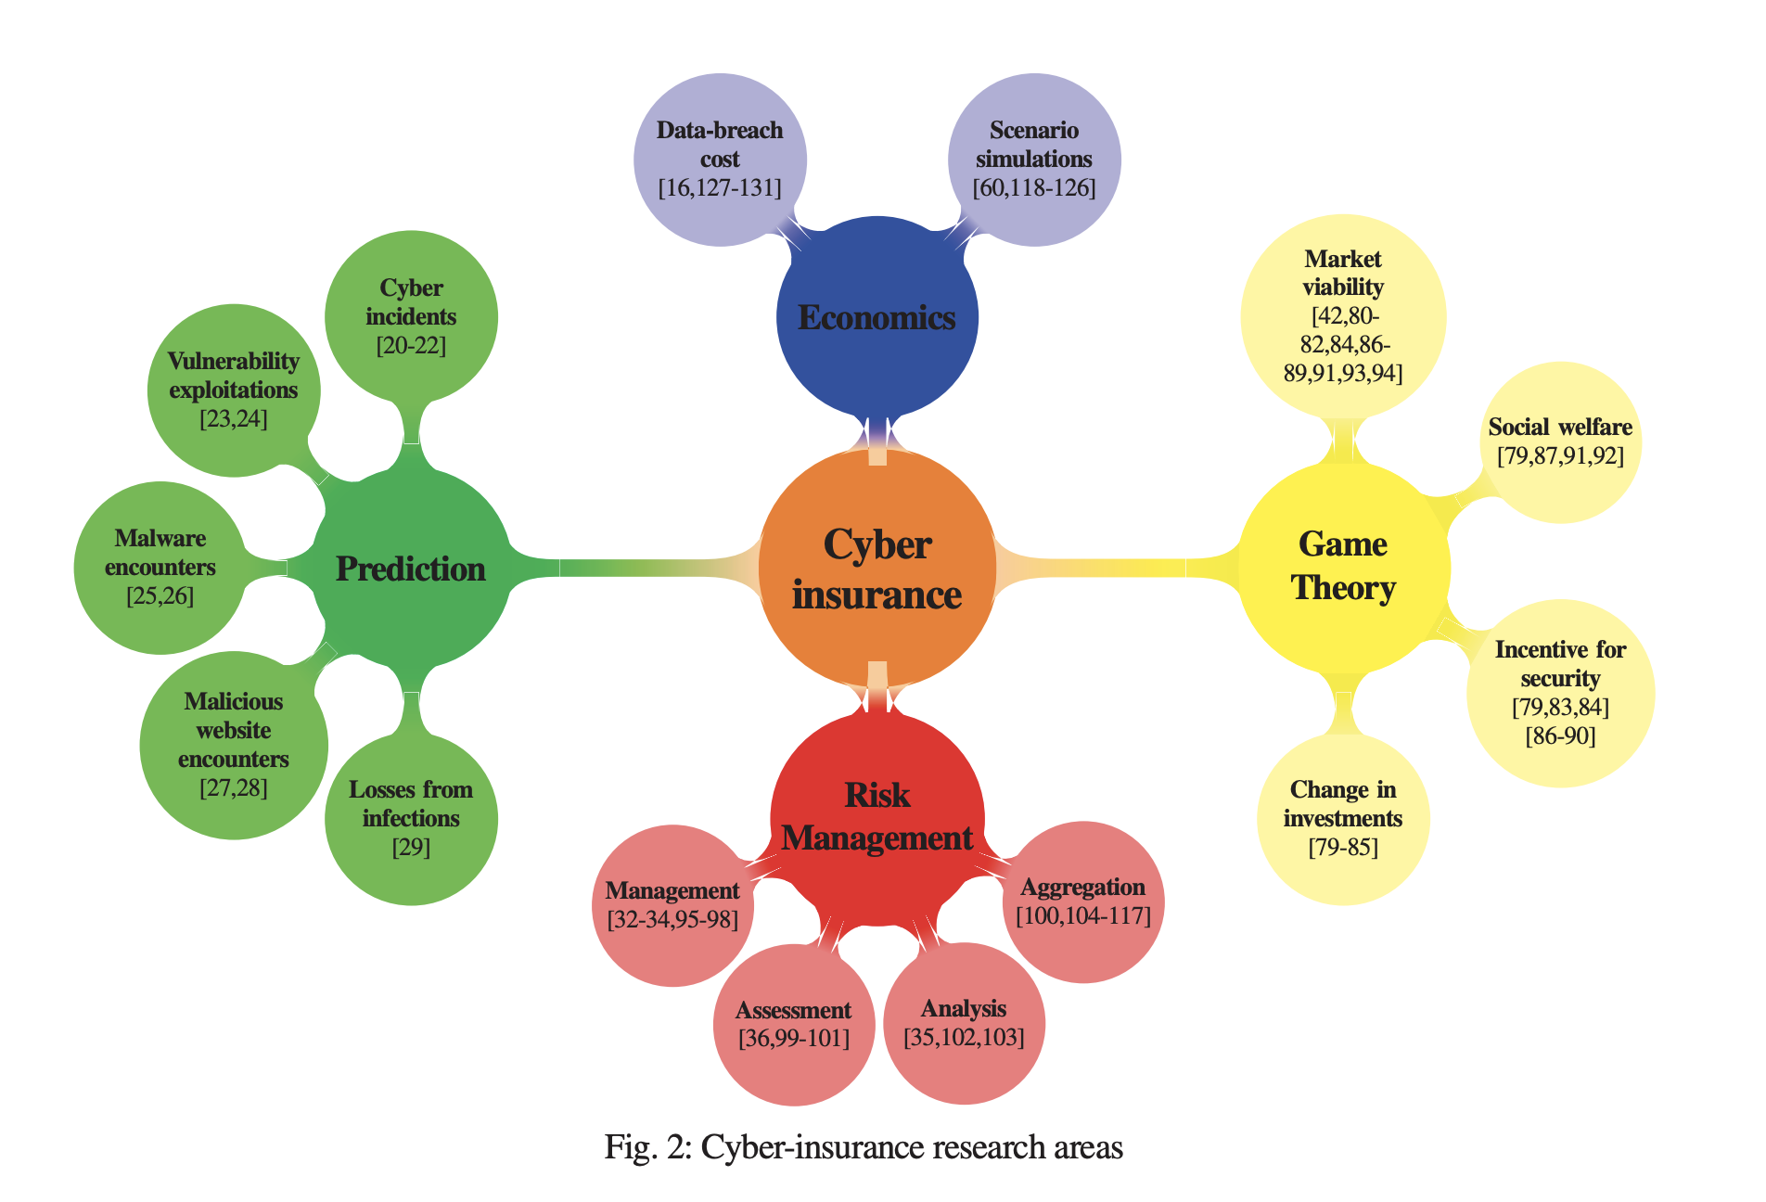
Notes:
What were some of the four main categorizations used in the paper?
This seems like a good categorization to me
I suppose the only way to tell otherwise would be to read all the papers yourself
Keep in mind that this is a taxonomization of the research surrounding cyber insurance, not a taxonomization of all the topics of cyber insurance itself.
Is that distinction clear?
Typical for an SoK — goal is to be “current state of the art” rather than “an introduction for beginners”
Often serve as good introductions regardless

Slide 50
Notes:
Risk management: measuring risk and developing strategies to monitor and control it.
Management: Frameworks for approaching how to do risk management.
Assessment: Identifying threats and their likelihoods
Analysis: “narrowing down the discussion on risk analysis” — presumably they had their reasons. I don’t see it.
Aggregation: Combining multiple risk metrics into a single cohesive metric

Slide 51
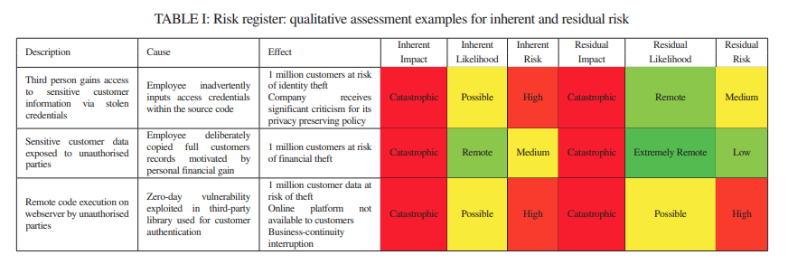
Notes:
What is the difference between likelihood and risk?
What is the difference between inherent (likelihood|risk) and residual (likelihood|risk)?
Inherent risk represents the amount of risk that exists in the absence of controls.
Residual risk is the amount of risk that remains after controls are accounted for.
Source: https://www.fairinstitute.org/blog/inherent-risk-vs.-residual-risk-explained-in-90-seconds

Slide 52
Notes:
Game theory: mathematically modeling decisions and incentives, network topologies of people in the game, etc.
Viability: Does insurance even rationally make sense? I.e. given information asymmetries. Maybe cute theoretical models but there is an existence proof that cyber insurance is viable
Social welfare: Is cyber insurance a net good or bad for society?
Incentives for security: Does it produce better security?
Change in investment: Does cyber insurance promote security investment?

Slide 53
Notes:
Third category is “The Economics Perspective”
Scenario “simulation”. I’m pretty sure this means more like tabletop wargaming among business executives rather than scientific monte carlo simulations.
Data breach cost: Empirical work on the relationship between the insurance and the costs of data breaches.

Slide 54
Notes:
Last is Prediction
Goal of prediction is to carry out risk estimation by leveraging a combination of risk indicators (like age, do they visit websites with misconfigured SSL certificates, etc.)

Slide 55
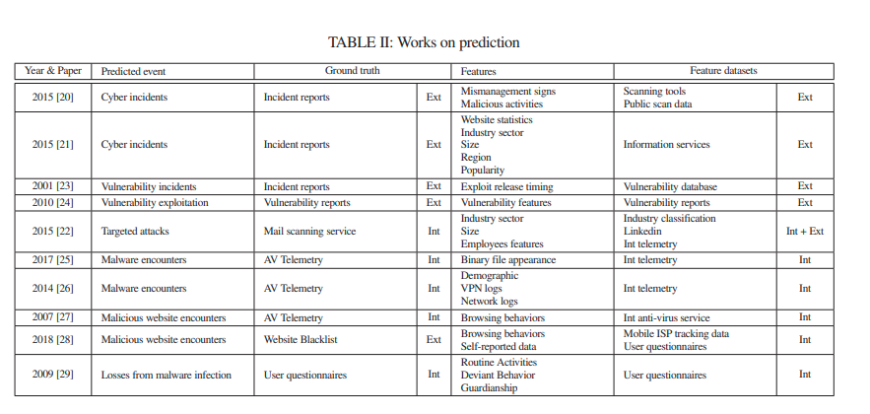
Notes:
What’s going on here?
Who has taken a class on machine learning?
These are different works on building classifiers that take some feature, and using a feature dataset, make predictions on the level of risk based on the chosen risk indicators.

Slide 56
Notes:
Ultimately, most of these techniques are trying to apply quantitative techniques to what is ultimately a qualitative foundation
Is this a good idea?
Probably the best we can do
Issue in presenting qualitative data quantitatively may trick us into forgetting that we’re ultimately on a qualitative foundation.
Or perhaps it’s exploited by cybersecurity companies, e.g. dashboard with all-green “all risks managed”.
False sense of security!

Slide 57
Why should the systems security community care about insurance?
“Help the development of quantitative, data-driven methodologies”
“Bring automation and support tools to replace questionnaires and qualitative estimations”

Slide 58
Area #1: Risk Prediction
Measure the security posture of the target
Measure the behavior of the target
Measure the attack surface
Influence of business sector, reputation, and assets of an organization
Predict future events based on historical data
Measure the risk that propagates through third-party relations
Users’ weakness and social engineering
Risk aggregation
Notes:
Privacy concerns re: behavior measurements?
My thoughts: These are all worthwhile things to pursue. But it reads like a wish list.
The first part of the paper sets up why cyber insurance is a hard thing to do well, for numerous reasons, and then this part of the paper says “now go ahead and address the issues”.
Feels a bit contradictory to me
Undoubtedly, technical systems people can make contributions here.
It’s very unclear what needs to be done. They are worthwhile high-level research goals, but more guidance could have been helpful
Particularly risk aggregation.
It might be easy enough to track specific indicators
It’s very hard to turn a collection of indicators into estimates of risk that are highly believable
This is why we started the semester by (trying to do) thinking in systems
Brainstorm ideas?

Slide 59
Area #2: Automated Data Collection
Romanosky et al. show that security questionnaires are very superficial
“Nevertheless, the extent to which security standards compliance reflect the level of risk a company faces has not been yet understood <R12>”
Notes:
“Nevertheless, the extent to which security standards compliance reflect the level of risk a company faces has not been yet understood <R12>”
Sound familiar? (This is some of your class projects)
Again, a good idea, but this might be yet another case of imposing quantitative methods on a qualitative foundation. Might deceive us, might be security theater.
Also, privacy issues.
Brainstorm ideas?

Slide 60
Area #3: Catastrophe modeling
Build service dependency graphs
Update since 2020: Current regulatory push for SBOMs
Hindered by dynamic nature of dependencies, hidden backups, etc.
Notes:
Brainstorm ideas?

Slide 61
Area #4: Forensic analysis
How to prevent the cyber equivalent of burning down your house for the insurance money
Is this a task for researchers or for practitioners?
Notes:
Brainstorm ideas?

Slide 62
Cyber Insurance
COMS6998 sec:12 Economics of Cybersecurity
5 March 2024
“An insurance salesman in an office, selling a cyber insurance policy to a concerned business executive”

